Slide 1
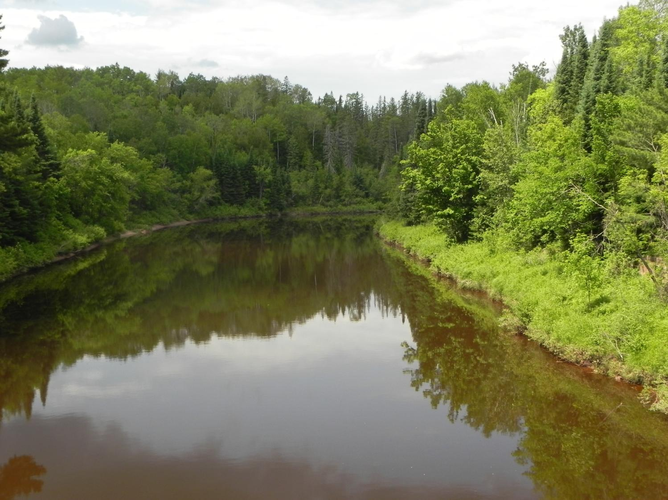

Wisconsin’s Forests in a Changing Climate
Maria Janowiak
Chris Swanston, Stephen Handler, Leslie Brandt, Patricia Butler, and Danielle Shannon
www.forestadaptation.org

Slide 2
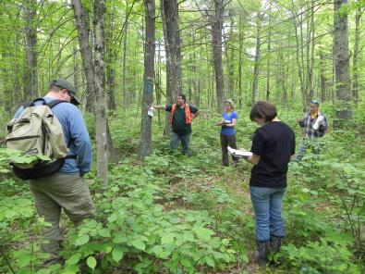
Outline
Climatic change in northern Wisconsin (review)
Effects on forest ecosystems
Options for responding
  Mitigation (briefly)
  Adaptation
Real-world example
  And activities!
  In the woods!

Slide 3
How is climate changing in our neck of the woods?

Slide 4
Temperature changes
1/5
Over the last 100 years, temperatures have _________.
Temperature changes have varied across season with the greatest warming in the _________.
Growing seasons have _________.
Notes:
Winter and Spring = warming!
Summer and Fall = warming, but not by as much
Minimum temps increasing faster than max temps for all seasons
Annual change = 1.4 f…..min = 2.2 F
What do you notice about here?

Slide 5

Temperature changes
Winter (Dec-Feb)
Spring (Mar-May)
Summer (Jun-Aug)
Fall
(Sep-Nov)
www.climatewizard.org
Notes:
Winter and Spring = warming!
Summer and Fall = warming, but not by as much
Minimum temps increasing faster than max temps for all seasons
Annual change = 1.4 f…..min = 2.2 F
What do you notice about here?

Slide 6
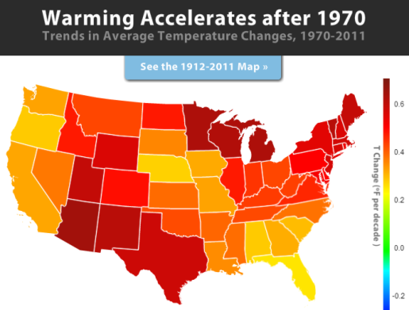
Additional Observations
US has warmed 1-2°F since the 60s-70s (Karl et al. 2009)
Lower 48 increased by 1.3 °F per century during 1901-2009 (EPA 2012 )
Warming since ’70:
  MI: 2nd fastest
  WI: 4th fastest

Slide 7
Additional Observations
In Wisconsin during 1950-2006 (Kucharik et al. 2011, WICCI)
  Winters have warmed more than other seasons
  Minimum temps increased 1.1-4.0 °F, which was more than maximum temps at 0.5-1.1 °F increase
  Days with a minimum below 0 °F occur 5-20 fewer days per year
  Days with a maximum over 90 °F have not changed substantially
  Growing season lengthened by 5-20 days across the state, with greatest change in the northwest

Slide 8
Precipitation changes
2/5
Over the last 100 years, precipitation across Wisconsin has_________.
These trends are _________.
Extreme precipitation events have become _________.
Notes:
Winter and Spring = warming!
Summer and Fall = warming, but not by as much
Minimum temps increasing faster than max temps for all seasons
Annual change = 1.4 f…..min = 2.2 F
What do you notice about here?

Slide 9
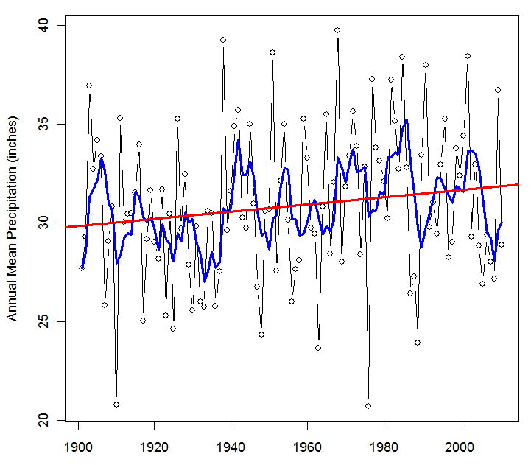
Observed Mean Annual Precipitation
1901-2011 precip change (inches)
Notes:
Substantial inter-annual fluctuation
Geographic variation

Slide 10
Precipitation changes
1901-2011 precip change (inches)
Winter (Dec-Feb)
Spring (Mar-May)
Summer (Jun-Aug)
Fall
(Sep-Nov)
www.climatewizard.org
Notes:
Summer and Fall – wetter!
Winter and Spring – wetter, but not by as much.
What do you notice about the North Shore and up around GM?

Slide 11
Extreme events
Frequency of 3”+ rainstorms
Michigan
Wisconsin
Saunders 2012
Notes:
Hydrologic cycle is becoming more episodic, more precip delivered in intense storms

Slide 12
Other Observed Changes
3/5
Other evidence that the regional climate is changing includes ___________.
Notes:
Winter and Spring = warming!
Summer and Fall = warming, but not by as much
Minimum temps increasing faster than max temps for all seasons
Annual change = 1.4 f…..min = 2.2 F
What do you notice about here?

Slide 13
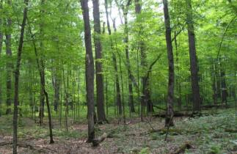
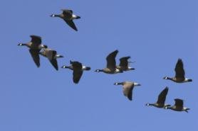
Other Observed Changes
Growing season shifts
Lake ice
Snowfall patterns
Migration events
Others?
Has leaves 11 more days
Arrive 29 days earlier
Notes:
Hundreds of lines of evidence – climate shift is real, and it’s having meaningful consequences.
Other examples on the info sheets Steve put up around the room.

Slide 14
How is climate going to change in our neck of the woods?

Slide 15
Projecting future changes
4/5
The degree of climate warming that we experience will depend upon _________.
Scientists use _________ to estimate and understand how the climate may change in the future.
Temperatures are likely to _________.
Notes:
Winter and Spring = warming!
Summer and Fall = warming, but not by as much
Minimum temps increasing faster than max temps for all seasons
Annual change = 1.4 f…..min = 2.2 F
What do you notice about here?

Slide 16
Future Changes: Emission Scenarios
Emission scenarios used:
A1FI (high)
B1 (low)

Slide 17
Projecting the Future
PCM
Low emissions (B1)
GFDL
High emissions (A1FI)
Least Projected Change
Most Projected Change
Notes:
Two biggest sources of uncertainty from humans – emissions and models
Let’s see how these combine to create a range of plausible future climates – bracketing a range of possible futures.
Showing downscaled climate data – can explain more about how these data were generated and the caveats that go along with downscaling climate projections.

Slide 18
Annual Temperature
PCM B1
GFDL A1FI
2010-2039
2040-2069
°F
2070-2099

Slide 19
Seasonal Temperature
2070-99
PCM B1
GFDL A1FI
Winter
°F
Spring

Slide 20
Seasonal Temperature
2070-99
PCM B1
GFDL A1FI
Summer
°F
Fall

Slide 21
Future precipitation changes
5/5
Annual precipitation is projected to ________.
Seasonally, precipitation is projected to ________________________________.
In winter, precipitation will __________
________________________________.
Notes:
Winter and Spring = warming!
Summer and Fall = warming, but not by as much
Minimum temps increasing faster than max temps for all seasons
Annual change = 1.4 f…..min = 2.2 F
What do you notice about here?

Slide 22
Annual Precipitation
PCM B1
2070-99
GFDL A1FI
inches

Slide 23
Seasonal Precipitation
Notes:
Central Apps
Greatest divergence is in the summer
Spring decreases mid-century before ultimately increasing

Slide 24
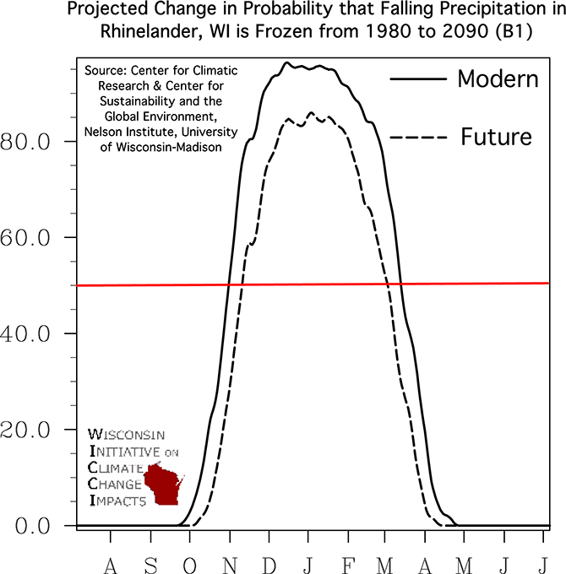
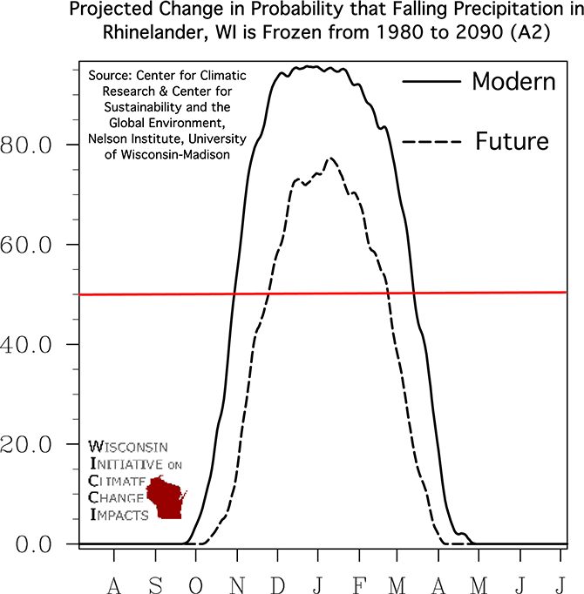
Additional Projections
Proportion of precipitation that is frozen (WICCI)
August
July
August
July

Slide 25
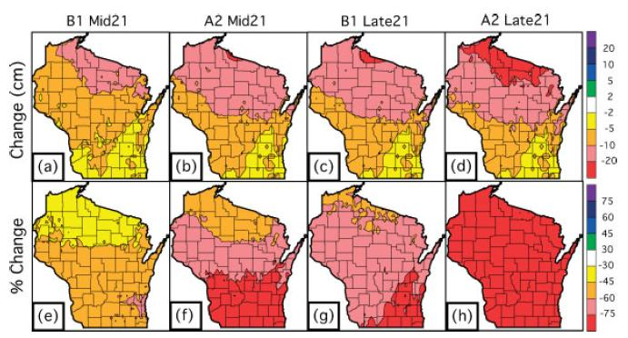
Additional Projections
Less snow, but…
Lake-effect snowfall not well modeled
Notaro et al.

Slide 26
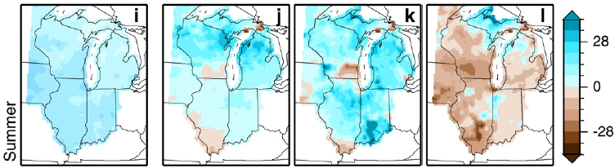
Hydrologic Changes
Annual high-flow days on streams projected to increase
  Greatest in winter and spring
Low-flow days also increased, but generally not as much
  Greatest reduction in summer and autumn
Overall stream flow (runoff) changes: more water in winter/spring; potential for less in summer/fall
Percent Change
1977-2006
2070-99 B1
2070-99 A1B
2070-99 A2
Total Runoff (Runoff + Baseflow)
Cherkauer and Sinha 2010

Slide 27
How are the trees and woods expected to change?

Slide 28
Benefits
Notes:
Increased productivity through…
Longer growing seasons
Evidence of phenological shifts
Meta-analysis
677 species (>400 plant spp.)
87% shifted in direction expected by climate change
Increased precipitation in some regions
Precipitation has increased in the 20th century
Not a uniform increase
Wet areas have gotten wetter, dry areas drier
Increases in high latitudes
Greater variability in equatorial regions
Variability in future projections is high
CO₂ fertilization
Increased photosynthesis
Reduced stomatal conductance
Increased water use efficiency
Potential increases in NPP
Potential increases in soil inputs
Increased foraging and voltinism
Minimum temps increasing 2x rate of maximum
Affecting broad suite of organisms
Positive effects on species such as Karner Blue Butterfly

Slide 29
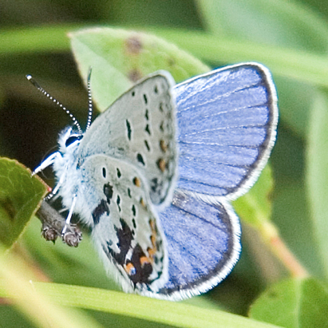
Benefits
Longer growing seasons
  Evidence of phenological shifts
  Positive effects on species such as Karner Blue Butterfly
Notes:
Increased productivity through…
Longer growing seasons
Evidence of phenological shifts
Meta-analysis
677 species (>400 plant spp.)
87% shifted in direction expected by climate change
Increased precipitation in some regions
Precipitation has increased in the 20th century
Not a uniform increase
Wet areas have gotten wetter, dry areas drier
Increases in high latitudes
Greater variability in equatorial regions
Variability in future projections is high
CO₂ fertilization
Increased photosynthesis
Reduced stomatal conductance
Increased water use efficiency
Potential increases in NPP
Potential increases in soil inputs
Increased foraging and voltinism
Minimum temps increasing 2x rate of maximum
Affecting broad suite of organisms
Positive effects on species such as Karner Blue Butterfly

Slide 30
Benefits
Longer growing seasons
  Evidence of phenological shifts
  Positive effects on species such as Karner Blue Butterfly
Increased precipitation in some regions
  Precipitation has increased in the 20th century
    Observed : wetter in NC WI, drier in west UP
  Variability in future projections is very high
Notes:
Increased productivity through…
Longer growing seasons
Evidence of phenological shifts
Meta-analysis
677 species (>400 plant spp.)
87% shifted in direction expected by climate change
Increased precipitation in some regions
Precipitation has increased in the 20th century
Not a uniform increase
Wet areas have gotten wetter, dry areas drier
Increases in high latitudes
Greater variability in equatorial regions
Variability in future projections is high
CO₂ fertilization
Increased photosynthesis
Reduced stomatal conductance
Increased water use efficiency
Potential increases in NPP
Potential increases in soil inputs
Increased foraging and voltinism
Minimum temps increasing 2x rate of maximum
Affecting broad suite of organisms
Positive effects on species such as Karner Blue Butterfly

Slide 31
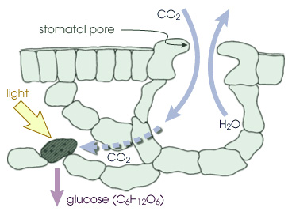
Benefits
Longer growing seasons
  Evidence of phenological shifts
  Positive effects on species such as Karner Blue Butterfly
Increased precipitation in some regions
  Precipitation has increased in the 20th century
CO₂ fertilization
  Increased photosynthesis
  Increased water use efficiency
Notes:
Increased productivity through…
Longer growing seasons
Evidence of phenological shifts
Meta-analysis
677 species (>400 plant spp.)
87% shifted in direction expected by climate change
Increased precipitation in some regions
Precipitation has increased in the 20th century
Not a uniform increase
Wet areas have gotten wetter, dry areas drier
Increases in high latitudes
Greater variability in equatorial regions
Variability in future projections is high
CO₂ fertilization
Increased photosynthesis
Reduced stomatal conductance
Increased water use efficiency
Potential increases in NPP
Potential increases in soil inputs
Increased foraging and voltinism
Minimum temps increasing 2x rate of maximum
Affecting broad suite of organisms
Positive effects on species such as Karner Blue Butterfly

Slide 32
Benefits
Longer growing seasons
  Evidence of phenological shifts
  Positive effects on species such as Karner Blue Butterfly
Increased precipitation in some regions
  Precipitation has increased in the 20th century
CO₂ fertilization
  Increased photosynthesis
  Increased water use efficiency
Species range shifts: increase in some species
  Tolerant of warmer, drier conditions
  Southern spp., oaks, black walnut, black cherry
  Depends on availability and migration potential
Notes:
Increased productivity through…
Longer growing seasons
Evidence of phenological shifts
Meta-analysis
677 species (>400 plant spp.)
87% shifted in direction expected by climate change
Increased precipitation in some regions
Precipitation has increased in the 20th century
Not a uniform increase
Wet areas have gotten wetter, dry areas drier
Increases in high latitudes
Greater variability in equatorial regions
Variability in future projections is high
CO₂ fertilization
Increased photosynthesis
Reduced stomatal conductance
Increased water use efficiency
Potential increases in NPP
Potential increases in soil inputs
Increased foraging and voltinism
Minimum temps increasing 2x rate of maximum
Affecting broad suite of organisms
Positive effects on species such as Karner Blue Butterfly

Slide 33
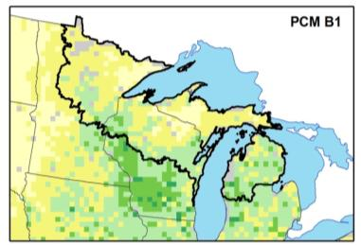
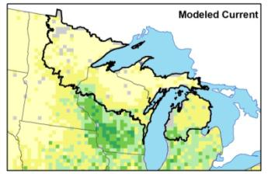
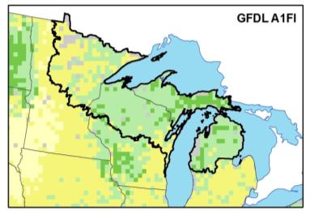
Benefits: White oak example
2070-2100 Low
Current FIA
Importance Value
Low
2070-2100 High
High
Iverson et al.
Notes:
These are samples – much more in Ch 5 of vulnerability assessment
Paper birch 0.87 to 0.23 Lg. Dec.

Slide 34
Increased Stresses

Slide 35
Increased Stresses
Acclimation to CO₂ fertilization
  Varies by species and site
  Nutrient deficiencies (especially N)
  Limited sink strength
  Sensitive to ozone pollution (+/-)
  Evidence increased NPP and biomass,
  but limited evidence of long-term sequestration
    Old trees
    Wood growth and soil carbon – varies
  The fertilization effect may be transitory, and photosynthesis may not stay elevated. Ecosystem carbon may not increase.
Oren et al 2001, Ainsworth and Long 2005, Jones et al 2005, Norby et al 2005, Ainsworth and Rogers 2007

Slide 36
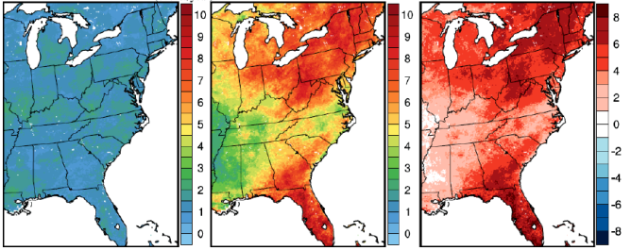
Increased Stresses
Acclimation to CO₂ fertilization
Extreme weather events
  Wind storms and hurricanes  Ice storms
  Heat waves and droughts  Heavy precipitation
  “Events” are not well modeled
Current)
2057-59
Change
Number of heat wave events per year
(Gao et al. 2012)

Slide 37
Increased Stresses
Acclimation to CO₂ fertilization
Extreme weather events
Longer growing seasons
  Altered timing of aquifer recharge
  Potential declines in summer seasonal stream flow
  Potential increases in flashiness and episodic high flows
  Increased water stress in late summer
  Phenological shifts and asynchrony
Dale et al 2001, Huntingon 2004, Parmesan 2006, Cherkauer and Sinha 2010

Slide 38
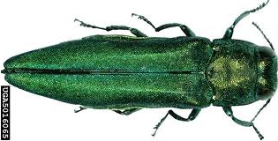
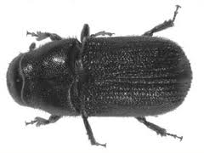
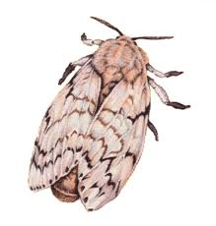
Increased Stresses
Acclimation to CO₂ fertilization
Extreme weather events
Longer growing seasons
Expanded pest and disease ranges
  Pests migrating northward
  Accelerated lifecycles
  Decreased probability of lower lethal temperatures
  Increased winter minimum temps → potential range expansion (hemlock wooly adelgid, mountain pine beetle)
Ayres and Lombardero 2000, Woods et al 2005, Parmesan 2006, Soja et al 2006

Slide 39
Increased Stresses
Acclimation to CO₂ fertilization
Extreme weather events
Longer growing seasons
Expanded pest and disease ranges
Decreased snow pack and early thaw
  Early bud break and loss of cold hardening
  Frost damage during spring freezing
  Less insulation in cold snaps
Ayres and Lombardero 2000, Hennon et al 2006

Slide 40
Increased Stresses
Acclimation to CO₂ fertilization
Extreme weather events
Longer growing seasons
Expanded pest and disease ranges
Decreased snow pack and early thaw
Increased frequency and intensity of fire

Slide 41
Increased Stresses
Acclimation to CO₂ fertilization
Extreme weather events
Longer growing seasons
Expanded pest and disease ranges
Decreased snow pack and early thaw
Increased frequency and intensity of fire
Species range shifts

Slide 42
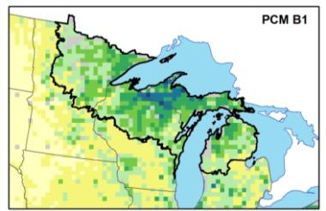
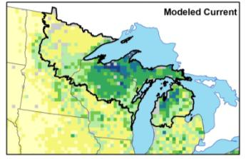
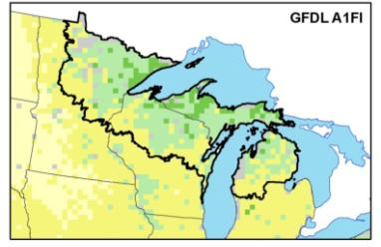
Stresses: Sugar maple example
2070-2100 Low
Current FIA
Importance Value
Low
2070-2100 High
High
Iverson et al.
Notes:
These are samples – much more in Ch 5 of vulnerability assessment
Paper birch 0.87 to 0.23 Lg. Dec.

Slide 43
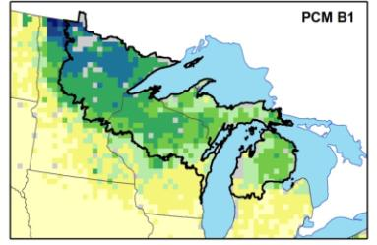
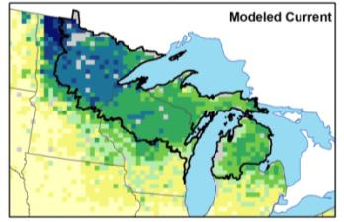
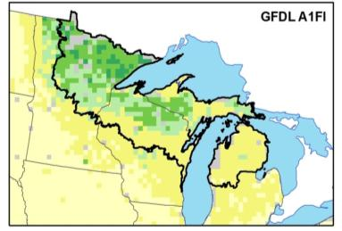
Stresses: Quaking aspen example
2070-2100 Low
Current FIA
Importance Value
Low
2070-2100 High
High
Iverson et al.
Notes:
These are samples – much more in Ch 5 of vulnerability assessment
Paper birch 0.87 to 0.23 Lg. Dec.

Slide 44
Increased Stresses
Species range shifts
  Range shifts ≠ instant catastrophic dieback
  Mature trees should fare better
    Developed root system
    Greater carbohydrate reserves
  Stress factors will increase in severity
    Temperature
    Moisture
    Competition
  Increased susceptibility to disturbance
Dale et al 2001, Iverson et al 2008

Slide 45
Increased Stresses
Precipitation
Temperature
CO₂ fertilization
Extreme weather events
Longer growing seasons
Expanded pest and disease ranges
Decreased snow pack and early thaw
Increased frequency and intensity of fire
Species range shifts
Interactions between these limitations and stressors are highly likely

Slide 46
Increased Ecosystem Vulnerabilities…
Risk will be greater in low diversity systems
Disturbance will destabilize static ecosystems
Greater problems for species already in decline
Resilience may be weakened in fragmented ecosystems
Further reductions in habitat will impact threatened, endangered, and rare species
Ecosystem changes will have significant effects on wildlife
Swanston et al 2011

Slide 47
Vulnerability Assessment (DRAFT)
Community Type | Potential Impacts | Adaptive Capacity | Vulnerability
Northern hardwoods | Moderate-Negative | Moderate-High | Moderate
Aspen-birch | Moderate-Negative | Moderate-High | Moderate-High
Upland spruce-fir | Negative | Moderate-Low | High
Lowland conifers | Negative | Moderate-Low | High
Jack pine | Moderate-Negative | Moderate-High | Moderate
Red pine | Moderate-Negative | Moderate-Low | Moderate-High
White pine | Moderate-Negative | High | Moderate-Low
Oak associations | Moderate | Moderate-High | Moderate- Low
Lowland-riparian hardwoods | Moderate-Negative | Moderate | Moderate-High
Notes:
Just a teaser of results – again, these are broad determinations for broad forest types across the whole assessment area.
Draft in prep right now.
Draw upon information from Vulnerability Assessment, but ALSO your own knowledge, local land ownership conditions, management goals and objectives

Slide 48
What can someone do if they care about forests?

Slide 49


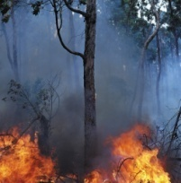
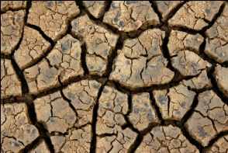
Options for Responding
PEOPLE
MITIGATION
ADAPTATION
Greenhouse Gases
Climate Change
CC Impacts

Slide 50
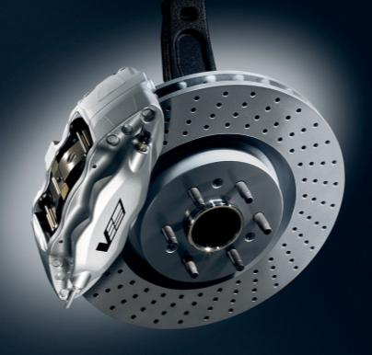
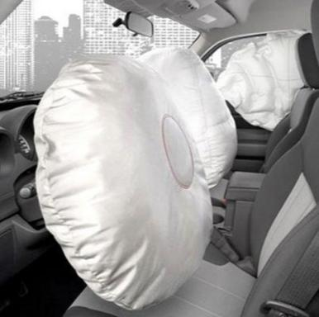
Options for Responding
Mitigation. Adaptation.
Notes:
Both can help reduce negative impacts!

Slide 51
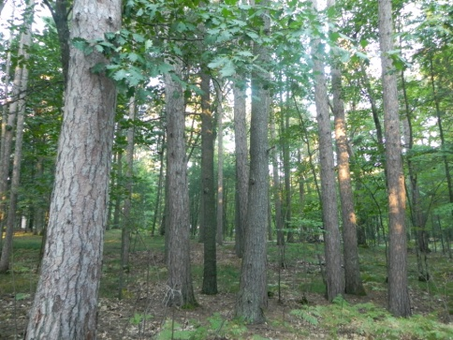
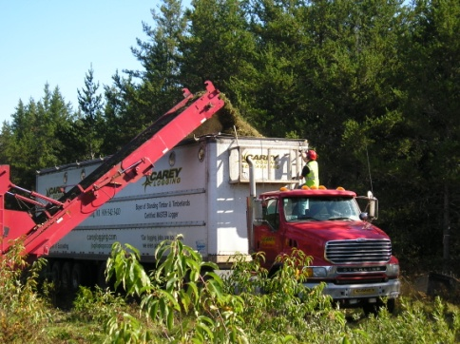
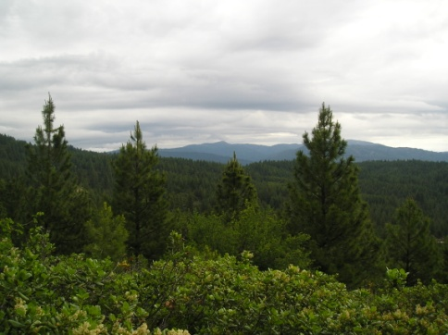
Greenhouse Gas Mitigation
Mitigation includes human actions to reduce the effects of climate change by reducing sources & enhancing sinks of greenhouse gases
Three broad categories:
  Emission avoidance
  Sequestration
  Substitution
IPCC 2007, Brown 1999, Maness 2009; Video: www.fs.fed.us/ccrc/carboncourse/
Notes:
Maness, T.C. 2009. Forest Management and Climate Change Mitigation: Good Policy Requires Careful Thought. Journal of Forestry. 107: 119-124.
IPCC = M. L. Parry, O. F. Canziani, J. P. Palutikof, P. J. van der Linden and C. E. Hanson, eds. Climate Change 2007: Impacts, Adaptation and Vulnerability. Contribution of Working Group II to the Fourth Assessment Report of the Intergovernmental Panel on Climate Change. Cambridge, UK: Cambridge University Press.

Slide 52
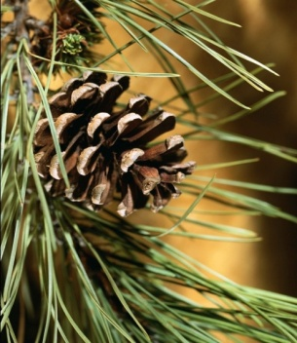
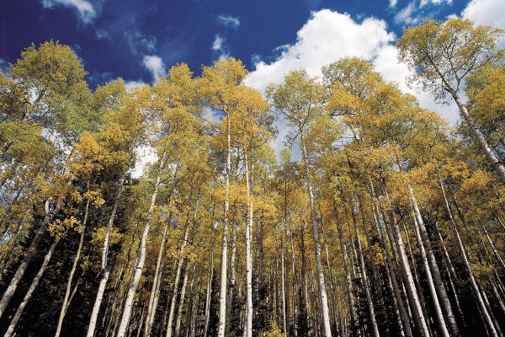
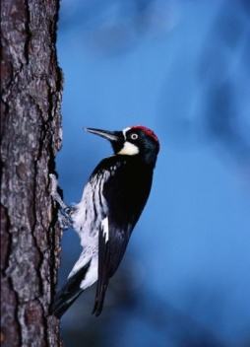
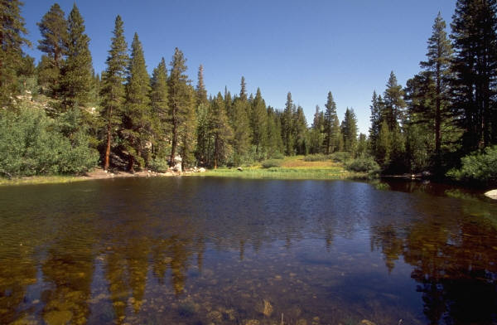
Adaptation
Adaptation is the adjustment of systems in response to climate change.
Ecosystem-based adaptation activities build on the sustainable management, conservation, and restoration of forests

Slide 53
Adaptation
Desired Future Condition
Time

Slide 54
Adaptation
Desired Future Condition
Climate Change
Trajectory
?
Time

Slide 55
Adaptation
Desired Future Condition
Increasing resources needed to maintain DFC
Climate Change
Trajectory
?
Time

Slide 56
Adaptation
Desired Future Condition
Climate Change
Trajectory
?
Time

Slide 57
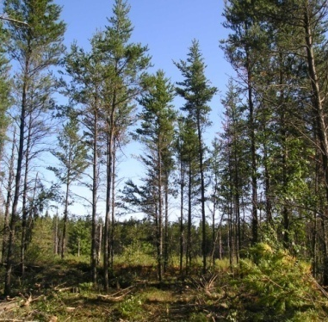
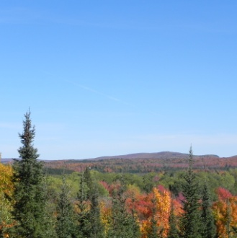
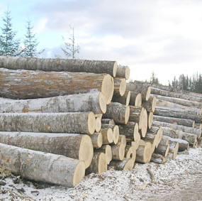
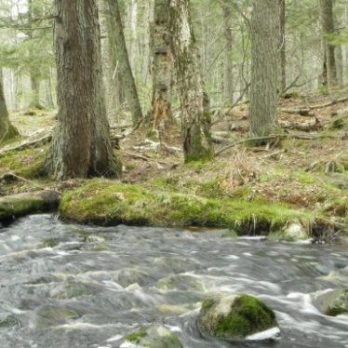
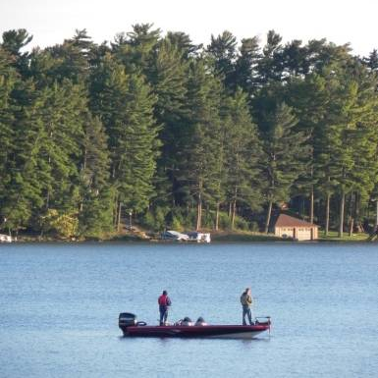
Adaptation: Important Points
There is not a single “answer” for how to respond to climate change.
Approaches may change over time.

Slide 58
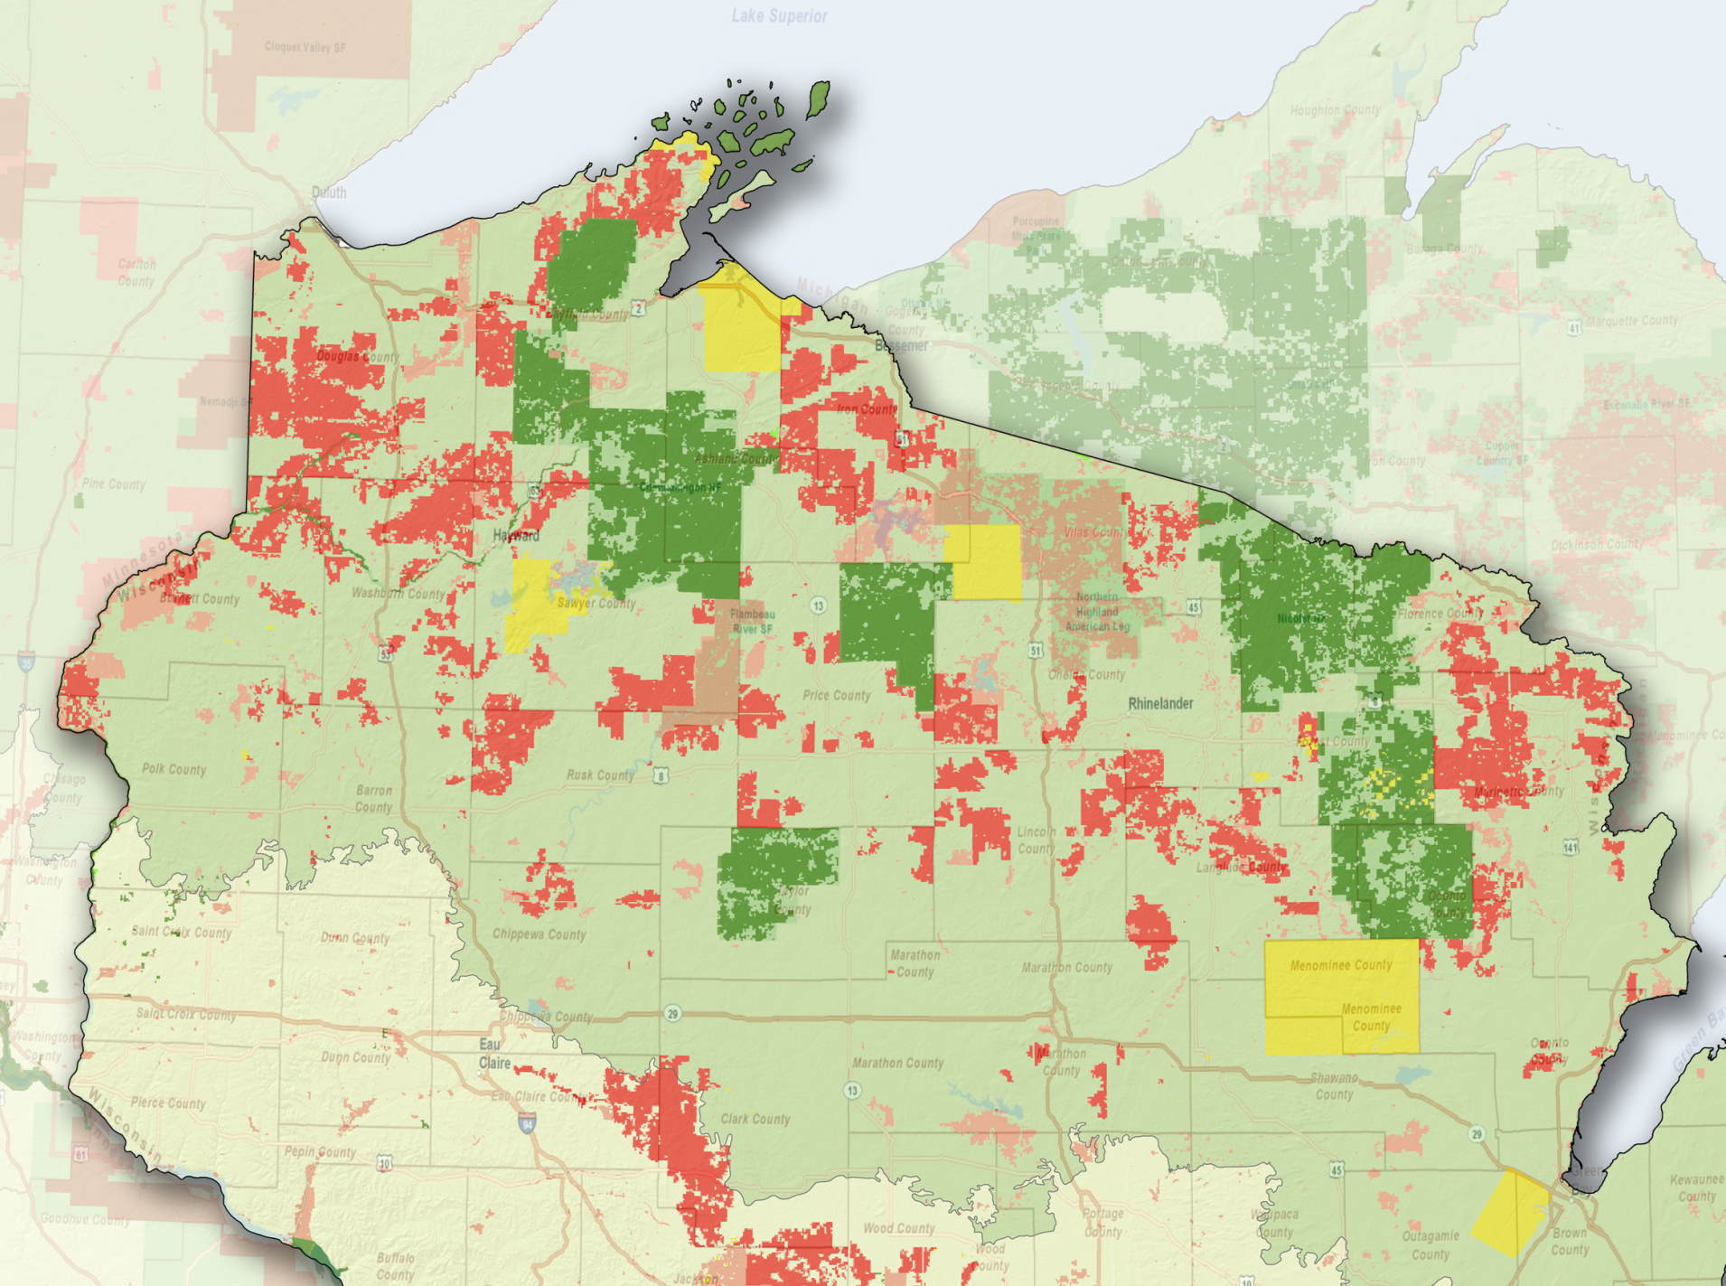

Adaptation Demonstration Projects
Minnesota’s North Shore (TNC)
Bad River Natural Resources Dept.
Ottawa National Forest (start-up)
Lincoln Community Forest
Caroline Lake (TNC)
Chequamegon-Nicolet National Forest (multiple)
Menominee Tribal Enterprises
Summaries online at: www.forestadaptation.org

Slide 59
Adaptation Process
1. DEFINE area of interest, management objectives, and time frames.
5. MONITOR and evaluate effectiveness of implemented actions.
2. ASSESS climate change impacts and vulnerabilities for the area of interest.
4. IDENTIFY and implement adaptation approaches and tactics .
3. EVALUATE management objectives given projected impacts and vulnerabilities.
Swanston and Janowiak 2012; www.nrs.fs.fed.us/pubs/40543

Slide 60
Adaptation Process: Deciphered
1. Where are you and what do you care about?
5. What data will show whether those actions were effective?
2. How is that particular place vulnerable to climate change?
4. What actions will lessen the negative effects of climate change?
3. What challenges or opportunities does climate change present?
Swanston and Janowiak 2012; www.nrs.fs.fed.us/pubs/40543

Slide 61
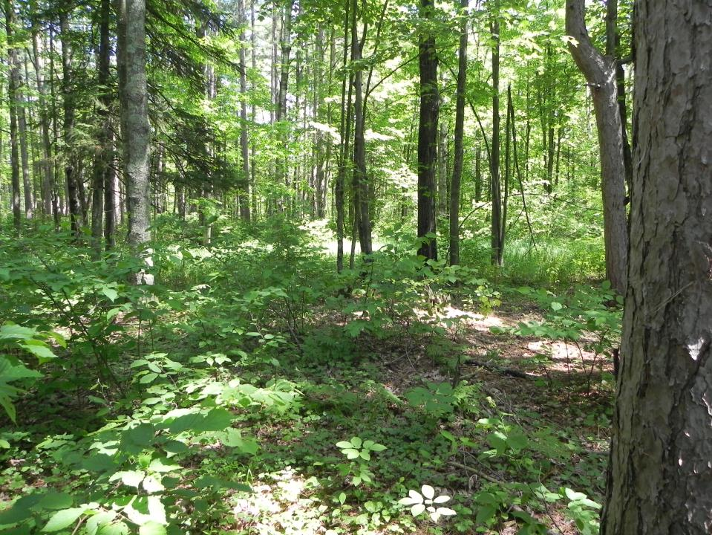
UP NEXT:
What’s this really look like in the woods??

Slide 62
Thank you!
Maria Janowiak
mjanowiak02@fs.fed.us
(906) 482-6303x29
My favorite climate change resources to recommend
www.forestadaptation.org: Our project website with many relevant documents and resources (and shameless self-promotion)
www.wicci.wisc.edu: Wisconsin Initiative on Climate Change Impacts = lots of great information!
www.climatewisconsin.org: Great videos about how climate change is affecting people in Wisconsin
www.fs.fed.us/ccrc: The Climate Change Resource Center is a website for natural resource professionals containing topic pages, videos, and other information.

